Slide 1
DBMS
Data –A piece of information that can be translated in to a form for effient movement and processing eg:name,class.
Data Base-Organized Collection of data stored in a computer system.
Data Base Management System-Software system that is designed to manage and organize data in a structured manner.
Relational DBMS-RDBMS are the most popular data model.
RDBMS defines database relationship in the form of tables.
Table-Collection of related data entries and it consist of rows and columns.Column hold specific info about every record in the table.A row is each individual entry that exist in the table.

Slide 2
MYSQL
MYSQL is a widely used relational Data Base Management System
MYSQL is free and open Source
MYSQL is released in 1995
MYSQL is developed by Oracle Co Operation.

Slide 3
SQL
Structured Query Language
SQL is the standard language for dealing with relational database
Standard language for querying and manipulating data
SQL keywords are not case sensitive
SQL Comment
single line comment :--
Multi line comment :/*………..*/

Slide 4
SQL Commands
SQL commands are the instructions used to communicate with a database to perform tasks, functions, and queries with data.
SQL commands can be used to search the database and to do other functions like creating tables, adding data to tables, modifying data, and dropping tables.
DDL -Data Definition Language
DML –Data Manipulation Language
DCL – Data Control Language
DQL - Data Query Language

Slide 5
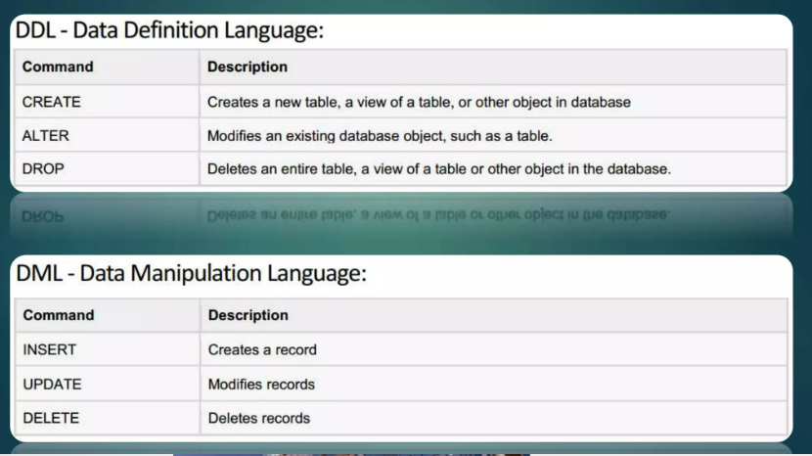

Slide 6
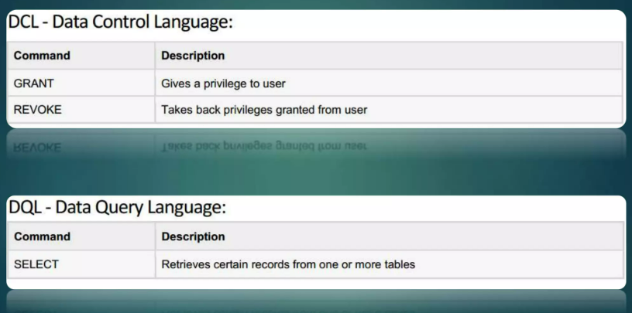

Slide 7
CREATE
CREATE DATABASE :stmt is used to create a SQL database
CREATE DATABASE database-name
CREATE DATABASE dbnew
CREATE TABLE :stmt is used to create a new table
CREATE TABLE table-name(column1 datatype,column2 datatype,……………..)
CREATE TABLE tbnew(id INT,NAME VARCHAR(50),age INT)

Slide 8
Auto increment
Auto-increment allows a unique number to be generated automatically when a new record is inserted into a table.
Often this is the primary key field that we would like to be created automatically every time a new record is inserted.
CREATE TABLE Persons (
Personid INT NOT NULL AUTO_INCREMENT,
LastName VARCHAR(255) NOT NULL,
FirstName VARCHAR(255),
Age INT,
PRIMARY KEY (Personid)
);

Slide 9
By default the starting value for auto increment is 1 and it will incremented by 1for each new record.
To let the auto increment sequence start with another value,use the following SQL statement
CREATE TABLE customerdetails(custid INT AUTO_INCREMENT,custname VARCHAR(60),age INT,address VARCHAR(100),PRIMARY KEY(custid))
ALTER TABLE `customer`AUTO_INCREMENT =100

Slide 10
DROP
DROP DATABASE : used to drop an existing SQL databas
DROP DATABASE database name
DROP DATABASE`dbnew`
DROP TABLE : used to drop existing SQL table
DROP Table table-name
DROP TABLE `customer`

Slide 11
ALTER
ALTER TABLE :Used to add delete or modify column in an existing table
ALTER TABLE table-name ADD column-name datatype
ALTER TABLE `customerdetails`ADD phone INT
ALTER TABLE table-name DROP COLUMN column-name
ALTER TABLE `customerdetails` DROP COLUMN phone
ALTER TABLE table-name MODIFY COLUMN column-name datatype
(to change datatype of a column)
ALTER TABLE `customerdetails` MODIFY phone VARCHAR(50)
ALTER TABLE table-name CHANGE Oldcolumn-name Newcolumnname datatype
ALTER TABLE table_name CHANGE `agenow` age INT

Slide 12
SQL Constraints
Can be specified when the table is created with the CREATE TABLE stmt or with ALTER TABLE stmt
SQL constraints are used to specify rules for the data in the table
Limit the type of data that can go into the table
This ensure the accuracy and reliability of data in the table

Slide 13
NOT NULL :Ensure that a column cannot have a NULL value
CREATE TABLE Persons ( ID int NOT NULL, LastName varchar(255) NOT NULL, FirstName varchar(255) NOT NUL);
UNIQUE :Ensure that all values in the column are different
CREATE TABLE Persons ( ID int NOT NULL, LastName varchar(255) NOT NULL, FirstName varchar(255), Age int, UNIQUE (ID) );
Primary Key :Combination of NOT NULL and UNOIQUE
CREATE TABLE Persons ( ID int NOT NULL, LastName varchar(255) NOT NULL, FirstName varchar(255), Age int, PRIMARY KEY (ID) );

Slide 14
Foreign Key :Prevents actions that would destroy links between table
CREATE TABLE oderdetails1(ID INT NOT NULL,Orderitem VARCHAR(50) NOT NULL,orderID INT,PRIMARY KEY (ID),FOREIGN KEY(orderID) REFERENCES ` orders`(`OrderID`));
Check :Ensure the value in a column satisfy a specific condition
CREATE TABLE Persons1 (ID INT NOT NULL ,LastName VARCHAR(255) NOT NULL,FirstName VARCHAR(255),Age INT,CHECK (Age>=18));
Default :Set a default value for column if no value specified
CREATE TABLE Persons (ID INT NOT NULL,LastName VARCHAR(255) NOT NULL,FirstName VARCHAR(255),Age INT,City VARCHAR(255) DEFAULT 'Sandnes');

Slide 15
INSERT INTO
INSERT INTO stmt is used to insert new record in a table
INSERT INTO table-name(c1,c2,c3……) VALUES(v1,v2,v3,…..)
INSERT INTO `customer`(`customername`,`agenow`,`adress`,`email`)
VALUES('anju',33,'calicut','anju@gmail.com')
OR
INSERT INTO table-name VALUES(V1,V2,V3….)
INSERT INTO CustomersVALUES ('Cardinal', 'Stavanger', 'Norway’);
INSERT INTO customerdetails VALUES(NULL,'dev','dubai’) //null

Slide 16
UPDATE
The UPDATE stmt is used to modify the existing records in a table
UPDATE table-name
SET C1=V1,C2=V2….
WHERE condition
*if you omit where clause all records in the table will be updated
UPDATE `customer` SET `adress`='wayanad' WHERE `customername`='anju'

Slide 17
Delete
DELETE stmt is used to delete existing records in atable
DELETE FROM table-name WHERE condition
DELETE FROM `customer` WHERE `customername`='manju'

Slide 18
SELECT
SELECT statement is used to select data from a database
The data returned is stored in result table is called result set
SELECT c1,c2…
from table-name
*C1,c2 are field names of a the table you want to select data from
SELECT FirstName,Age FROM persons
If you want to select all fields avail in the table
SELECT * FROM table-name
SELECT * FROM customer
Select distinct is used to return distinct values
SELECT DISTINCT c1 FROM table-name
SELECT DISTINCT`City`FROM ` persons`

Slide 19
WHERE Clause
WHERE clause is used to filter records
it is used to extract only those records that full fill a specific condition
SELECT c1,c2,….
FROM table-name
WHERE condition
SELECT custname,age FROM customerdetails WHERE address='calicut'
where clause is not only used in select stmt .it is also used in UPDATE DELETE etc

Slide 20
MYSQL AND OR and NOT Operators
Where clause can be combined with AND OR NOT Operators,to filter records based on more than one condition
SELECT c1,c2…
FROM t1
WHERE con1 AND con2 AND con3
SELECT c1,c2…
FROM t1
WHERE con1 OR con2 OR con3
SELECT c1,c2…
FROM t1
WHERE NOTcon1

Slide 21
SELECT custname,age FROM customerdetails WHERE address='calicut' AND age=33
SELECT custname,age FROM customerdetails WHERE address='calicut' OR age=33
SELECT custname,age FROM customerdetails WHERE NOT address='calicut'

Slide 22
ORDER BY KEYWORD
used to sort result set in ascending or descending order.
Order by sort Ascending by default
Keyword ASC|DESC for Ascending|Descending
SELECT * FROM customerdetails ORDER BY custname
SELECT * FROM customerdetails ORDER BY custname DESC

Slide 23
NULL Values
A field with NULL value is a field with no value
It is not possible to test for NULL values with comparison operator
We will have to use the ‘ISNULL’ and ‘IS NOT NULL’ operator instead
Select custname ,Address
From customer
Where address IS NULL
‘IS NULL’ is look for NULL values ‘IS NOT NULL’ used to test for non empty values
SELECT * FROM customerdetails WHERE address IS NULL
SELECT * FROM customerdetails WHERE address IS NOT NULL

Slide 24
LIMIT
Used to specify the number of records to return
SELECT * FROM customer LIMIT 3 // Return first 3 records//
SELECT * FROM `customerdetails` LIMIT 3
SELECT * FROM `customerdetails` WHERE `customerid`>3 LIMIT 2
Offset
SELECT * FROM CUSTOMER LIMIT 3 OFFSET 3 //select records 4 5 6//

Slide 25
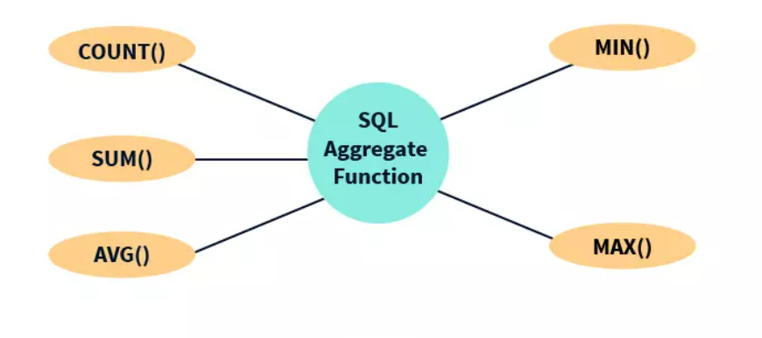
Aggregate Function
An Aggregate function in SQL performs a calculation on multiple values and return a single value.SQL provides many aggregate functions.

Slide 26
MIN():smallest value of selected column
SELECT MIN(price) FROM `order`
MAX():largest value of selected column
SELECT MAX(price) FROM `order`
COUNT():return number of rows that matches specified condition
SELECT COUNT(id) FROM `order`
AVG():Average value of a numeric column
SELECT AVG(price) FROM `order`
SUM():Total sum of numeric column
SELECT SUM(price) FROM `order`

Slide 27
LIKE
Like operator is used in a where clause to search for a specific pattern in a column
SELECT c1,c2..
FROM t1
WHERE cn LIKE pattern
There are two wildcard often used in conjunction with LIKE operator
% :represents zero one or more multiple characters
_ :represents one single characters

Slide 28
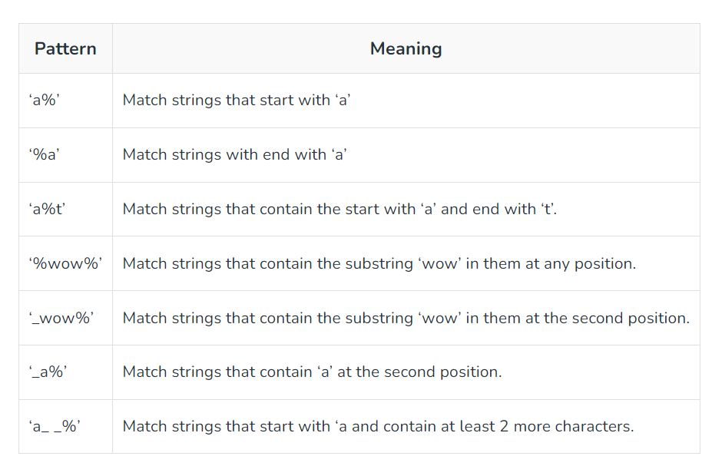

Slide 29
SELECT * FROM customerdetails WHERE custname LIKE 'a%’
SELECT * FROM customerdetails WHERE custname LIKE '%a’
SELECT * FROM customerdetails WHERE custname LIKE 'a%u'

Slide 30
In OPERATOR
IN Operator allows you to specify multiple values in a WHERE clause
IN operator is a shorthand for multiple OR condition
SELECT column-name(s)
FROM table-name
WHERE column-name IN(value1,value2,…..)
SELECT * FROM customerdetails WHERE address IN('calicut','wayanad')
OR
SELECT column-name(s)
FROM table-name
WHERE column-name IN (SELECT stmt)

Slide 31
BETWEEN Operator
BETWEEN operator selects value with in a given range
The value can be numbers text or data
Select column-name
From table name
Where column-name BETWEEN value1 AND value2
select * from product where price BETWEEN 10 AND 20

Slide 32
ALIASES
Aliases are used to give a table or a column in a table,a temporary name
An aliases is created with ‘AS’ keyword
SELECT column-na
me AS alias-name FROM table-name
SELECT `custname` AS customerName FROM `customerdetails`

Slide 33
Group by
GROUP BY stmt groups rows that have the same values in the summary rows
GROUP BY stmt is often used with aggregate fun to group the result set by one or more column
SELECT COUNT(`customerid`),`country` FROM `customerdetails` GROUP BY `country`

Slide 34
HAVING CLAUSE
Having clause added to SQL Because the WHERE keyword cannot be used with aggregate function
SELECT COUNT(`customerid`),`country` FROM `customerdetails` GROUP BY `country` HAVING COUNT(`customerid`)>2

Slide 35
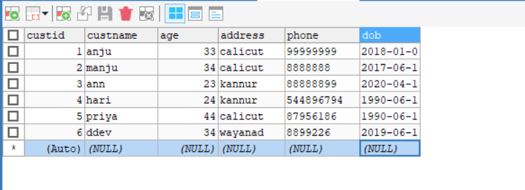
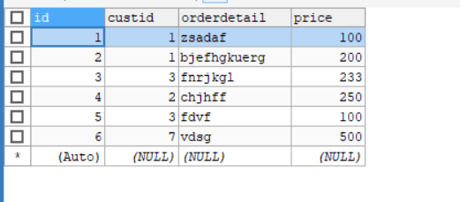
MYSQL JOIN
A JOIN clause is used to combine row from two or more tables based on a related column between them.

Slide 36
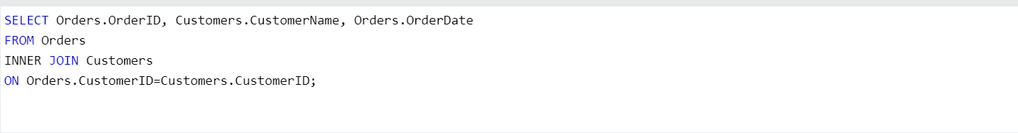
Then we can create the following SQL stmt that select record that have matching values in both table

Slide 37
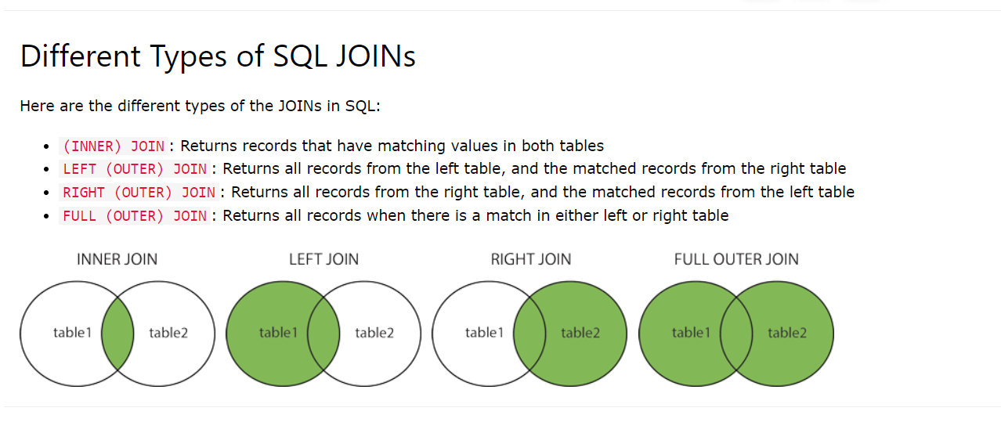

Slide 38
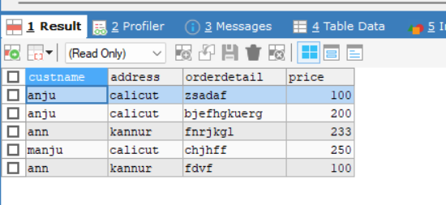
INNER JOIN
SELECT column_name(s) FROM table1 INNER JOIN table2 ON table1.column_name = table2.column_name;
SELECT `customerdetails`.`custname`,`customerdetails`.`address`,`order`.`orderdetail`,`order`.`price` FROM `customerdetails` INNER JOIN `order` ON `customerdetails`.`custid`=`order`.`custid`

Slide 39
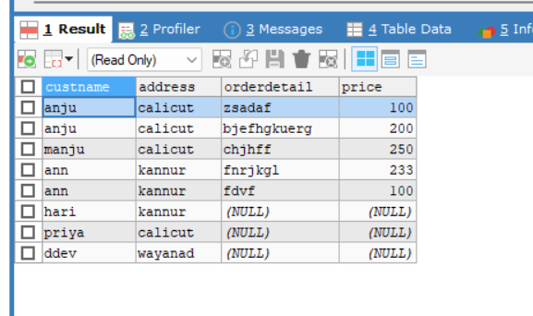
LEFT JOIN
SELECT column_name(s) FROM table1 LEFT JOIN table2 ON table1.column_name = table2.column_name;
SELECT `customerdetails`.`custname`,`customerdetails`.`address`,`order`.`orderdetail`,`order`.`price` FROM `customerdetails` LEFT JOIN `order` ON `customerdetails`.`custid`=`order`.`custid`

Slide 40
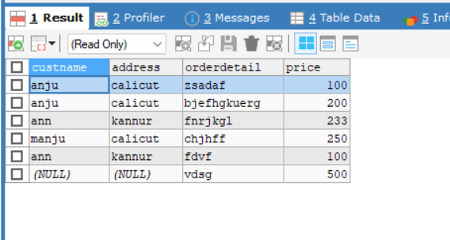
RIGHT JOIN
SELECT column_name(s) FROM table1 RIGHT JOIN table2 ON table1.column_name = table2.column_name;
SELECT `customerdetails`.`custname`,`customerdetails`.`address`,`order`.`orderdetail`,`order`.`price` FROM `customerdetails` RIGHT JOIN `order` ON `customerdetails`.`custid`=`order`.`custid`

Slide 41
FULL JOIN
Full join is not supported in mysql

Slide 42
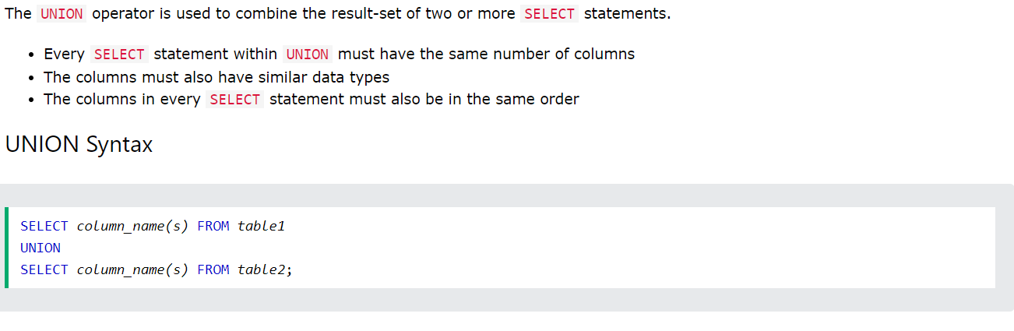
Union operator
SELECT city FROM customer UNION SELECT city FROM supplier

Slide 43
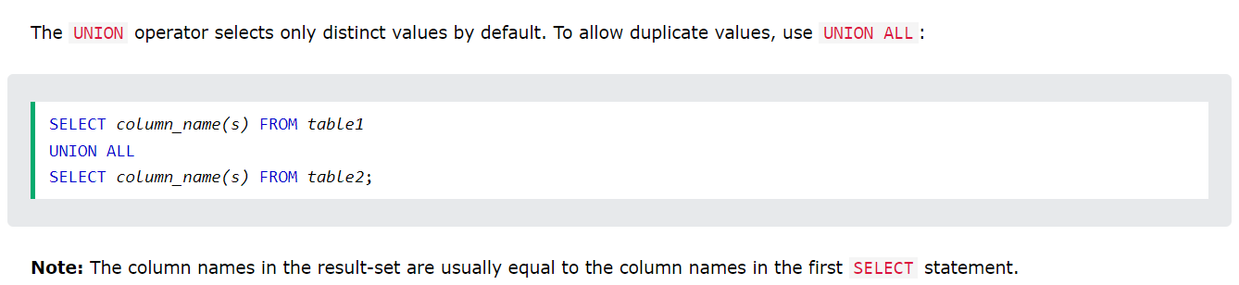
SELECT city FROM customer UNION ALL SELECT city FROM supplier

Slide 44
Scalar function
Scalar functions are the built-in functions in SQL, and whatever be the input provided to the scalar functions, the output returned by these functions will always be a single value
SELECT UCASE(city) FROM `customer`
SELECT LCASE(city) FROM `customer`
SELECT ROUND (18000.44444, 1) AS RoundedValue;
SELECT LENGTH(`custname`) FROM `customerdetails`
SELECT NOW() //currentdate and time

Slide 45
Date datatype
Date:YYYY-MM-DD
Datetime:YYYY-MM-DD HH-MI-SS
Year:YYYY OR YY
SELECT FLOOR(DATEDIFF(CURDATE(),dob)/365.25) AS age FROM `customerdetails`

Slide 46
Thank You

